Slide 1
Linux Q&A
A list of Linux related Q&As.

Slide 2
FAQs of Linux!

Slide 3
FAQs of Linux!
How to Login to Linux Operating System?
How to Implement Linux OS?
To log in to a Linux operating system, boot the system and wait for the login prompt.
If using a graphical user interface (GUI), enter the username and password in the provided fields.
In a command-line interface (CLI) environment, type the username and press Enter, then type the password and press Enter again.
If logging in remotely, use SSH by executing `ssh username@hostname` from another machine.
Implementing Linux involves downloading a distribution such as Ubuntu, Fedora, or Debian and installing it on a machine.
The process includes creating a bootable USB drive using software like Rufus or Balena Etcher, configuring the BIOS/UEFI settings to boot from USB, and following the installation wizard.
Post-installation steps include setting up user accounts, updating packages, and configuring system preferences.

Slide 4
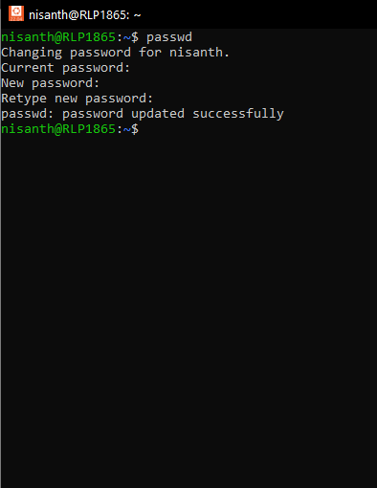

FAQs of Linux!
How to Change Password?
To change the password, use the `passwd` command in the terminal.
Type `passwd`, press Enter, and provide the current password followed by the new password twice.
For changing another user’s password, use `sudo passwd username`.

Slide 5
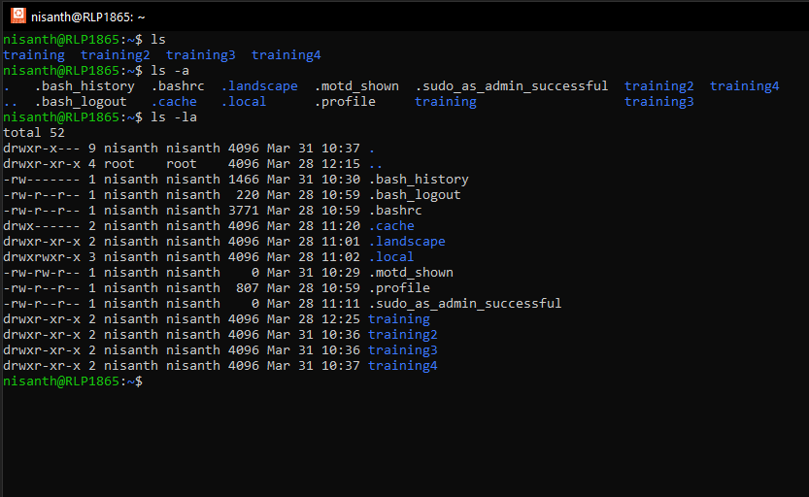
FAQs of Linux!
How We Are Listing Directories and Files?
Files and directories can be listed using the `ls` command.
Running `ls` displays non-hidden files, while `ls -l` provides detailed information.
To include hidden files, use `ls -la`.

Slide 6
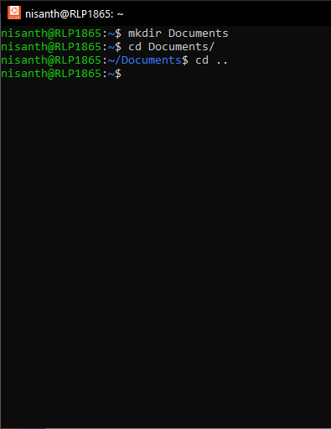
FAQs of Linux!
How to Change Directories?
To navigate directories, use the `cd` command followed by the directory name.
For example, `cd Documents` moves to the Documents directory.
To return to the home directory, use `cd ~`, and to go up one level, use `cd ..`.

Slide 7
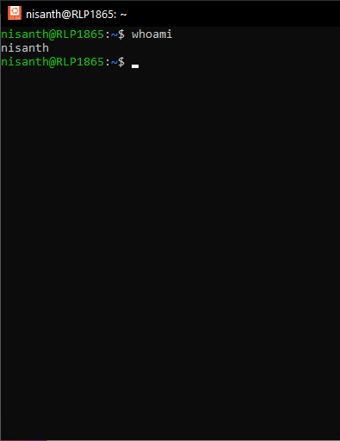
FAQs of Linux!
Who Are You?
To identify the logged-in user, run the `whoami` command. This command prints the username currently in use.

Slide 8
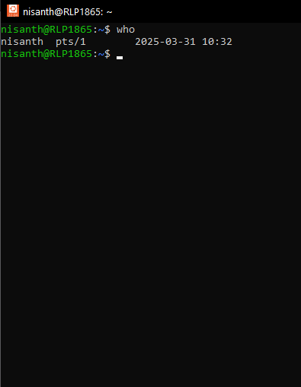
FAQs of Linux!
Who is Logged in?
To see all logged-in users, use the `who` command, which lists active sessions along with login times and originating terminals.

Slide 9
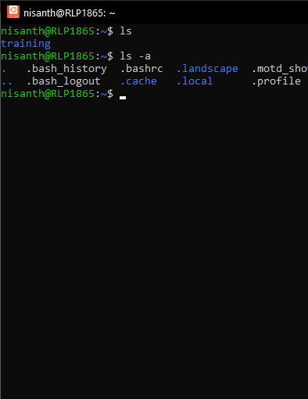
FAQs of Linux!
How to List Hidden or Invisible Files?
Hidden files in Linus environments begin with a dot (`.`) and can be displayed using `ls -la`.

Slide 10
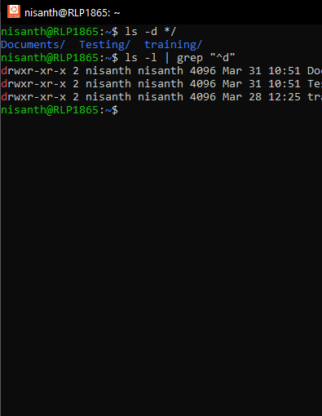
FAQs of Linux!
How to List Directories?
To list only directories, use `ls -d */` or `ls -l | grep "^d"`.

Slide 11
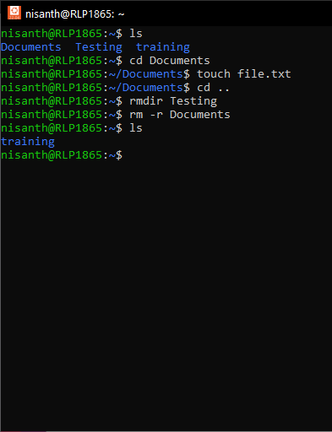
FAQs of Linux!
How to Remove Directories?
To delete empty directories, use `rmdir directory_name`. To remove directories and their contents, use `rm -r directory_name`.

Slide 12
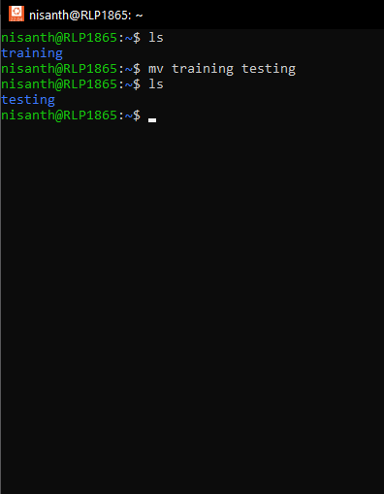
FAQs of Linux!
How to Rename Directories?
Renaming directories is done with the `mv` command: `mv old_directory_name new_directory_name`.

Slide 13
FAQs of Linux!
How to Download Ubuntu OS?
How to Install Ubuntu OS?
To download the Ubuntu operating system, visit the Ubuntu website and choose the "Download Desktop" option, then select the latest LTS version to download the ISO file, which you'll then use to create a bootable USB drive for installation.
Install Ubuntu Desktop
Create a bootable USB, configure boot settings, and follow the installation prompts, setting up partitions and user accounts.

Slide 14
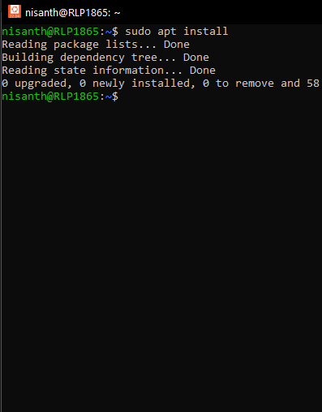
FAQs of Linux!
How to Install Software on Ubuntu?
Use `sudo apt install package_name` for APT-based distributions or `sudo dnf install package_name` for Fedora.

Slide 15
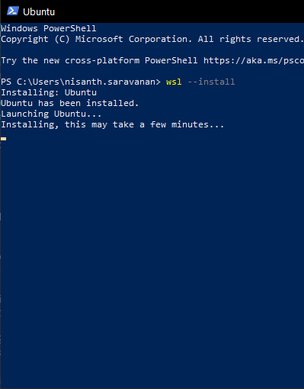
FAQs of Linux!
How to Install Linux on Windows with WSL?
Enable WSL using `wsl --install` in PowerShell. Install a distribution via the Microsoft Store and set up the environment.

Slide 16
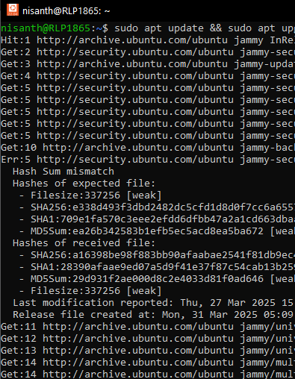
FAQs of Linux!
How to Update and Upgrade Packages Using WSL?
Run `sudo apt update && sudo apt upgrade` to update package lists and install upgrades.

Slide 17
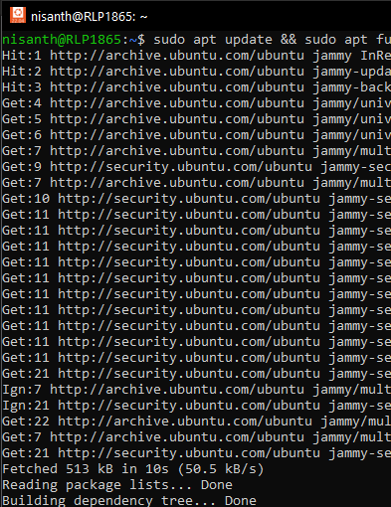
FAQs of Linux!
How to Update Your Linux Distribution?
Use `sudo apt update && sudo apt full-upgrade` for Debian-based systems.

Slide 18
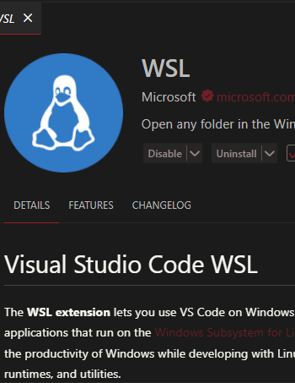
FAQs of Linux!
How to Work with Remote Development in WSL?
Use VS Code with the Remote WSL extension or SSH to connect to remote servers.

Slide 19
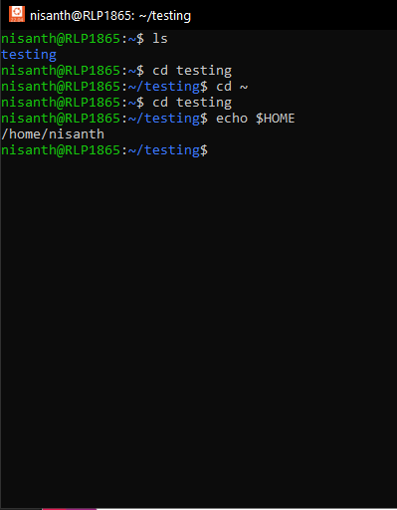
FAQs of Linux!
How to Find the Home Directory?
Use `echo $HOME` or `cd ~`.

Slide 20
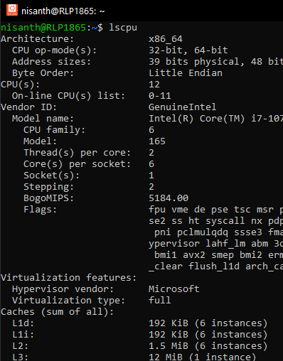
FAQs of Linux!
How to Find CPU Architecture Using lscpu?
Run `lscpu` to display CPU details.

Slide 21
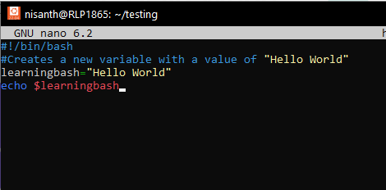
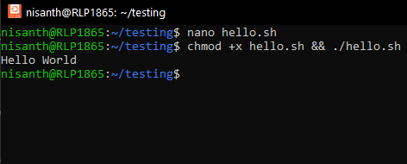
FAQs of Linux!
How to Create and Execute Bash Scripts?
Create a script with `nano script.sh`, add `#!/bin/bash`, write commands, save, and execute using `chmod +x script.sh && ./script.sh`.

Slide 22
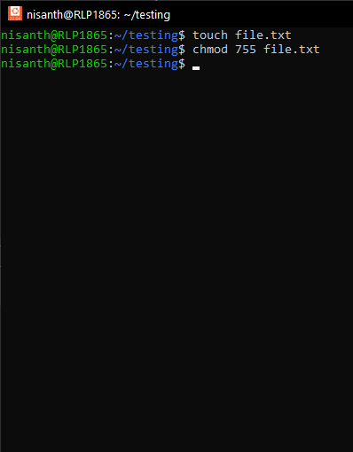
FAQs of Linux!
How to Change Permissions Using Absolute Mode?
To change permissions using absolute mode, use the chmod command followed by a three-digit octal number and the filename or directory.
Example:
chmod 755 filename would give the owner read, write, and execute permissions, while the group and others would have read and execute permissions.

Slide 23
FAQs of Linux!
How to Change Permissions Using Absolute Mode?
Octal Numbers:
Each digit in the octal number represents permissions for a specific user type (owner, group, others).
First digit: Represents permissions for the owner.
Second digit: Represents permissions for the group.
Third digit: Represents permissions for others (or world).

Slide 24
FAQs of Linux!
How to Change Permissions Using Absolute Mode?
Permissions:
Each digit can be a number from 0 to 7, representing:
0: No permission.
1: Execute permission.
2: Write permission.
3: Write and Execute permission.
4: Read permission.
5: Read and Execute permission.
6: Read and Write permission.
7: Read, Write, and Execute permission.

Slide 25
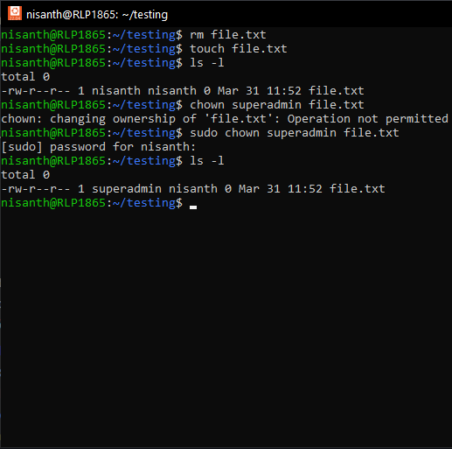
FAQs of Linux!
How to Change Ownership?
Use `chown new_owner filename`.

Slide 26
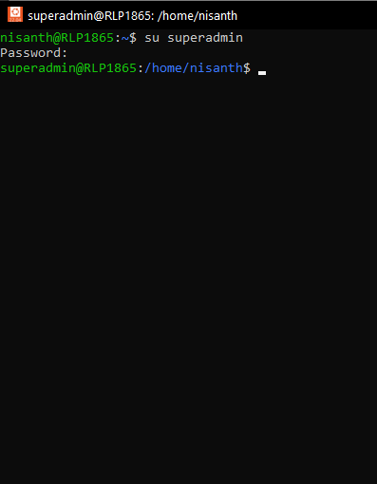
FAQs of Linux!
How to Switch Between Users?
Use `su username` and enter the password.

Slide 27
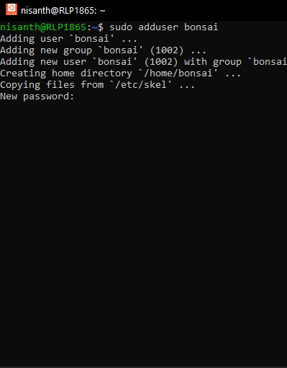
FAQs of Linux!
How to Create Users from the Command Line?
Run `sudo adduser new_username`.

Slide 28
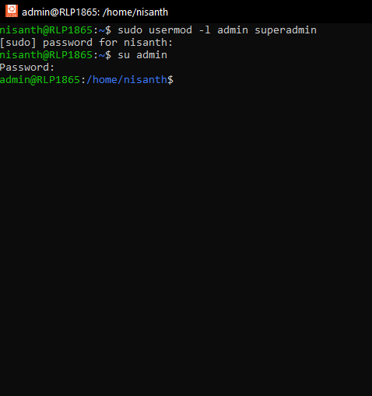
FAQs of Linux!
How to Change a User's Login Name?
Use `sudo usermod -l new_username old_username`.

Slide 29
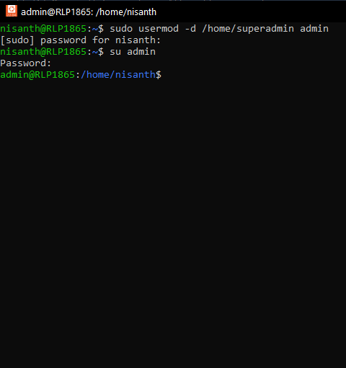
FAQs of Linux!
How to Change a User's Home Directory?
Run `sudo usermod -d /new/home/dir username`.

Slide 30
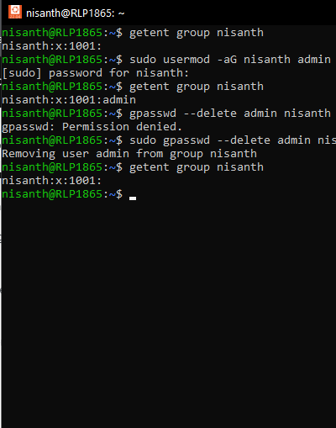
FAQs of Linux!
How to Add a User to a Supplementary Group?
Use `sudo usermod -aG groupname username`.

Slide 31
FAQs of Linux!
How to Remove a User from a Supplementary Group?
Run `sudo gpasswd -d username groupname`.

Slide 32
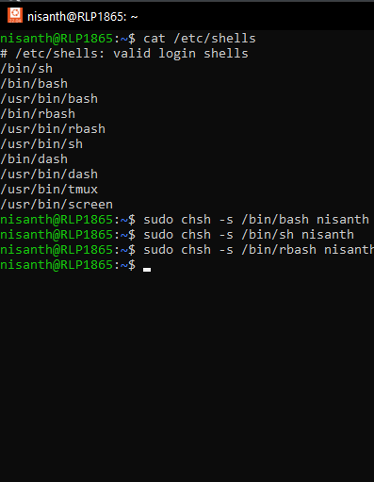
FAQs of Linux!
How to Change a User's Shell?
Use `sudo chsh -s /bin/bash username`.

Slide 33
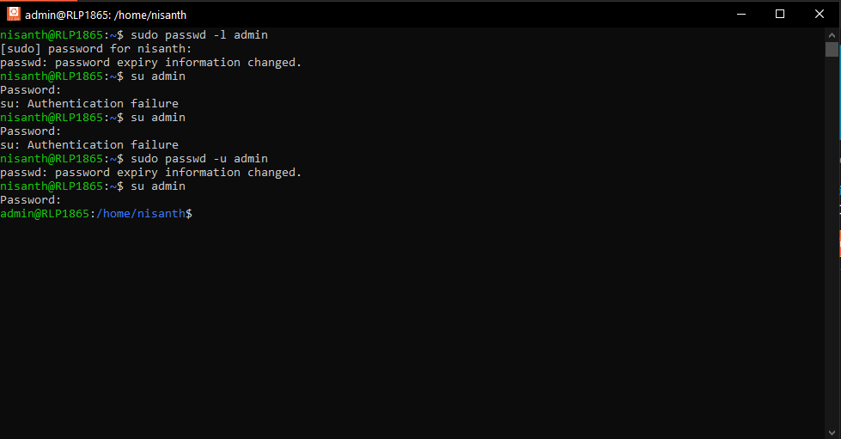
FAQs of Linux!
How to Lock a User's Account?
Use `sudo passwd -l username`.

Slide 34
FAQs of Linux!
How to Unlock a User's Account?
Use `sudo passwd -u username`.

Slide 35
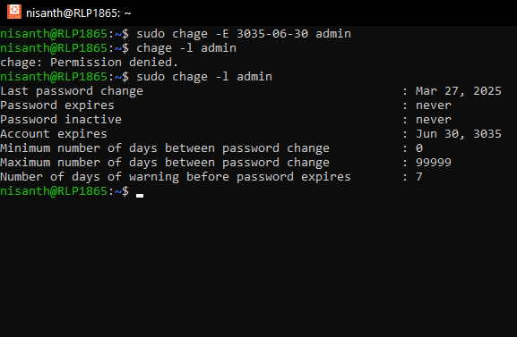
FAQs of Linux!
How to Set an Expiration Date for a User Account?
Use `sudo chage -E YYYY-MM-DD username`.

Slide 36
FAQs of Linux!
How to Unlock a User's Account?
Use `sudo passwd -u username`.

Slide 37
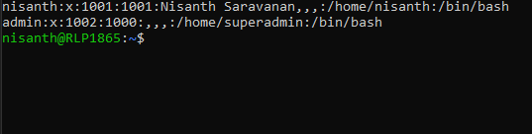
FAQs of Linux!
How to Change a User's User ID (UID)?
Run `sudo usermod -u new_uid username`.

Slide 38
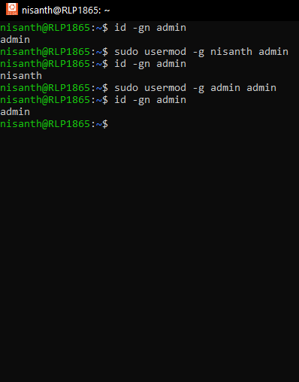
FAQs of Linux!
How to Change a User's Primary Group?
Use `sudo usermod -g groupname username`.

Slide 39
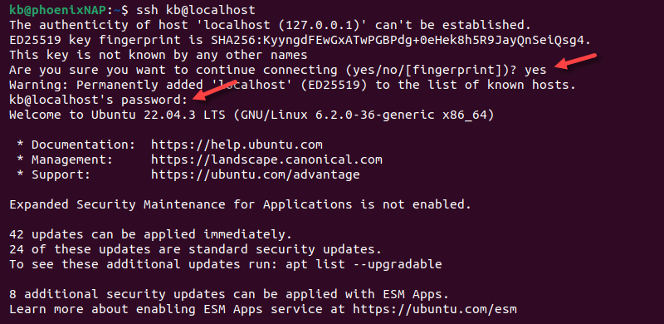
FAQs of Linux!
How to Connect to a Remote Server Using SSH?
Use `ssh username@remote_host`.

Slide 40
Nisanth Saravanan

